Slide 1
18ECO134T – Sensors and Transducers
Unit III : Session 4 : SLO 1
SRM Institute of Science and Technology
‹#›
Notes:
Pl use Font Family : Arial Narrow
To enhance the teacher presentations and the overall comprehension of students, it allows to present their lessons in a more dynamic and effective way. Set a Learning Objective:
1. Write an Outline for Key Ideas
2. Give the Presentation About Education a "Why"
3. Share Techniques and Tips for the Topic
4. Teach With Visualizations
5. Use Animations Carefully
‹#›

Slide 2
Thermocouple types

Slide 3
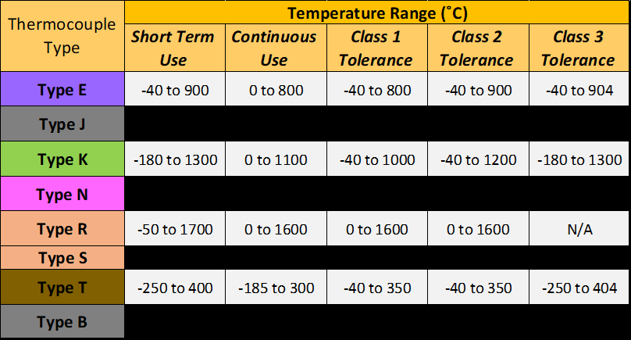
TYPES

Slide 4
Type E Thermocouple
The Type E thermocouple is composed of a nickel-10% chromium (+) versus a nickel-45% copper (-) wire. This Type of thermocouple can be used in oxidizing or inert atmospheres with a service temperature range of -200°C to 900°C (330°F to 1600°F).
The Type E thermocouple can be used successfully in subzero applications due to high corrosion resistance to high moisture environments. Out of all of the different types of thermocouples, Type E has the highest EMF output per degree.

Slide 5
Type J Thermocouple
The Type J thermocouple is composed of an iron (+) wire versus a nickel-45% copper (-) wire. This type of thermocouple should be used in oxidizing, reducing, vacuum or inert atmospheres with a service temperature range between 0°C and 760°C (32°F to 1400°F).
If the thermocouple is being used over 540°C (1000°F) an 8 gauge wire should be used due to rapid oxidation of the iron (+) wire. Type J thermocouples should not be used in sulfurous applications above 540°C (1000°F).
The negative element, or JN, of a Type J thermocouple can be described by any of the following names Constantan, ThermoKanthal -JNs, HAI-JN1, Cuprona, or, Advances. The positive element, or JP, of a Type J thermocouple can be described by any of the following names: ThermoKanthal-JPs, and lron.

Slide 6
Type K Thermocouple
The Type K thermocouple is composed of a Nickel-10% chromium (+) wire versus a nickel-5% aluminum and silicon (-) wire. This type of thermocouple should only be used in oxidizing or inert atmospheres with a service temperature range between -200°C and 1260°C (-330°F to 2300°F).
They are most widely used at temperatures above 540’C (1000″F) due to superior oxidation resistance in comparison to Types E, T, or J. There are some conditions which should be avoided when using Type K thermocouples. Vacuum applications should not use Type K due to vaporization of chromium in the positive element.
Type K thermocouples should not be used in Sulfurous environments since both elements will rapidly corrode and the negative element will eventually fail mechanically due to becoming brittle.

Slide 7
Type N Thermocouple
The Type N thermocouple is composed of a nickel-14% chromium-1 1/2% silicon (+) wire versus a nickel 4 1/2% silicon-1/10% magnesium (-) wire. The Type N thermocouple is the newest addition to the ISA family. lt was developed to be used under the same conditions as a Type K. Type N should be used in oxidizing or inert atmospheres with a service temperature range between -200°C and 1260°C (-330°F to 2300°F).
The addition of silicon and chromium makes this type of thermocouple more resistant to Green-Rot and less drifting when compared to a Type K. The negative element, or NN, of a Type N thermocouple can be described by any of the following names: Nisil, nickel-silicon, or, HAI-NN1.

Slide 8
Type R Thermocouple
The Type R thermocouple is composed of a platinum-13% rhodium (+) wire versus a platinum (-) wire. This type of thermocouple can be used in oxidizing or inert atmospheres with a service temperature range between 0°C and 1480°C (32°F1o 2700°F).
They should never be used in reducing atmospheres. As with all platinum type thermocouples, they should always be protected with a ceramic protection tube. Alumina insulators and protection tubes preferred to prevent silica contamination from Mullite ceramics.

Slide 9
Type S Thermocouple
The Type S thermocouple is composed of a platinum-10% rhodium (+) wire versus a platinum (-) wire. This type of thermocouple can be used in oxidizing or inert atmospheres with a service temperature range between 0°C and 1480°C (32°F to 2700°F).
They should never be used in reducing atmospheres. As with all platinum type thermocouples, they should always be protected with a ceramic protection tube. Alumina insulators and protection tubes are preferred to prevent silica contamination from Mullite ceramics.

Slide 10
Type T Thermocouple
The Type T thermocouple is composed of a copper (+) wire versus a nickel-45% copper (-) wire. The Type of thermocouple is frequently referred to as copper-constantan.
This type of thermocouple can be used in oxidizing, reducing, or inert atmospheres with a service temperature range between -200°C and 370°C (-330°F to 700°F). The high-temperature use of this thermocouple is also limited due to rapid oxidation of the copper element.

Slide 11
Type B Thermocouple
The Type B thermocouple is composed of a platinum-30% rhodium (+) wire versus a platinum-6% (-) wire. This type of thermocouple can be used in oxidizing or inert atmospheres with a service temperature range between 870°C and 1700°C (1000°F to 3100°F). They should never be used in reducing atmospheres.
Vacuum applications are possible for short periods of time. As with all platinum type thermocouples, they should always be protected with a ceramic protection tube. Alumina insulators and protection tubes are preferred to prevent silica contamination from Mullite ceramics.

